Slide 1
Preparing for Fiscal Year End
April 13, 2016

Slide 2
In this webinar, we’ll …
get you thinking about year end close,
point you to some resources for help, and
introduce a set of queries that help you review in-flight transactions, which is an important part of getting ready for year-end close.

Slide 3
Introductions
Anita Collins, ConnectCarolina Change Management
Chris Minter, ConnectCarolina Change Management
Collette Wilshire, Finance Continuous Improvement
Becky Arnold, Finance Business Analysis
Robin Burke, Finance Business Analysis

Slide 4
About the Webinar
Use the chat window to type your questions—we’ll answer at the end.
We’re recording the webinar, and it will be posted in a few days on ccinfo.unc.edu.

Slide 5
It’s Time to Get Started
It’s April: year end is just around the corner.
Communications are coming with hard and fast dates from the State, including a formal memo from the Controller
But don’t wait! Getting ready for year end might take longer than you expect, so go ahead and get started.
We also wanted to go ahead and share with you the resources we have, even though we’ll be updating them as we know more:
The Year End webpage on ccinfo.unc.edu
The Year End Checklist

Slide 6
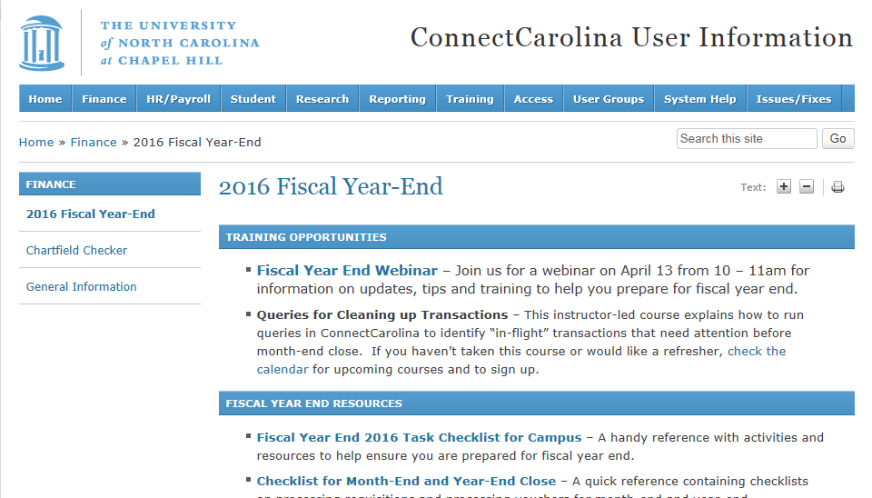
Resources to Help You: Year End Webpage
On ccinfo.unc.edu, click the Finance menu, then 2016 Fiscal Year-End

Slide 7
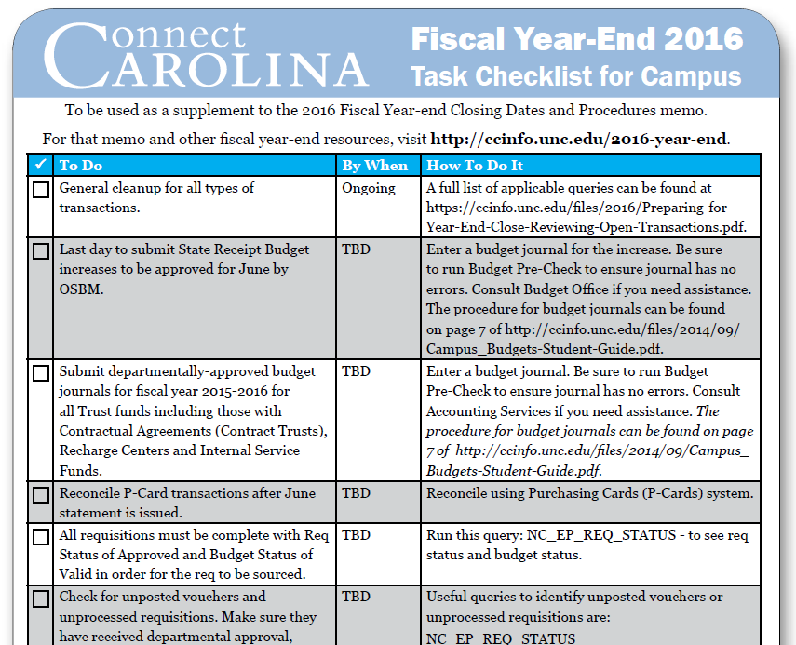
Resources to Help You: Year End Checklist
On the Year End Page on ccinfo.unc.edu

Slide 8
If you manage budgets …
In early May, we’re hosting a webinar that gives details on what you need to know for budgets in the new fiscal year.
Stay tuned on date and time.
The webinar is targeted to MOU leads, but all are welcome.

Slide 9
Goal 1
Spend your State funds early – our recommendation is by the end of April.
Example: Don’t wait until June to enter a Staples order to use up your State funds.
That purchase has to be matched and paid before the transaction is completed and the funds are gone.
If anything goes wrong, you need time to resolve.
If you’ve overspent your State funds, make correcting journal entries by the deadline.

Slide 10
Goal 2
Process all transactions up to the point that all departments have approved (and the transactions have moved to the central office).
For each type of transaction that is open, figure out why the transaction is stuck, and then either:
Delete it
or
Resolve the issue and then get it through departmental approval before the date specified by Accounting Services.

Slide 11
Go Ahead and Start
!
IMPORTANT: Be sure to start addressing open transactions NOW.
We have queries to help you do that.

Slide 12
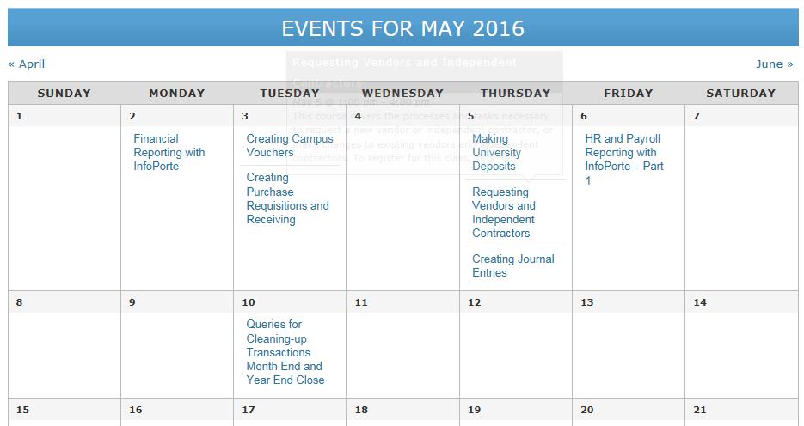
Hands-on Training Available
Today’s webinar gives an overview and refresher on the queries.
We offer a hands-on class on the queries—sign up on the ccinfo.unc.edu website.

Slide 13
Queries for Cleaning Up In-Flight Transactions

Slide 14
What happens to each type of transaction:
All campus journals, budget journals, and budget transfers must be completed through departmental approval before the day of the month specified by Accounting Services or they will be deleted.
Vouchers roll forward from month to month, but they can’t roll from year to year. Any vouchers not processed at year end will be deleted.
It is also important to manage your open requisitions and purchase orders, and if you aren’t going to fully process them, delete them.
All requisitions must be closed or fully cancelled. If they are not, they are subject to being cancelled by central office.
Purchase orders with an open balance can roll to the next year if all related documents are in the correct status.

Slide 15
Three areas where your transactions can get stuck:
1
Edit errors: checks the system does on the transaction, such as making sure:
the chartfield combination is valid (combo edits)
dates are valid
the PO, voucher, and receipt match
Budget errors
Unposted for any reason (for example, still in approvals)
2
3

Slide 16
Queries for Managing Transactions
The queries you need are in our student guide on the ccinfo.unc.edu Resources page.

Slide 17
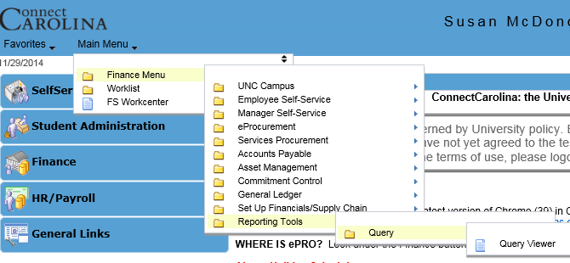
Getting to Query Viewer
Main Menu >
Finance Menu >
Reporting Tools >
Query >
Query Viewer

Slide 18
Running a Query
Type the name of the query.
Type part of the name to see all queries that begin with what you type.
You can use the % sign as a wildcard.
Examples:
Typing NC returns all queries that begin with NC.
Typing NC_AP_EDIT returns all queries that begin with NC_AP_EDIT
Click Search.

Slide 19
Running a Query
Click the HTML link to view the query results in your browser, or click Excel to export the results to a spreadsheet.
Important: You will see other queries besides the ones we just talked about. Only use the ones we listed—the others may not be complete or useable.

Slide 20
Running a Query
The Favorite link saves the query to a Favorites list within Query Viewer:

Slide 21
Running a Query
Enter uncch or uncga in the Unit field.
For GL journals, the business unit is uncch, uncga, or a foundation business unit. For all other transactions, the business unit is uncch or uncga.
Business unit is required.
You can’t use the wildcard for the business unit.
Enter a department or a partial department using the wildcard or underscore.
The Dept field cannot be blank.
Click View Results.

Slide 22
Edit queries: key fields
Online = combo edit error (invalid or missing chartfields)
AP_MATCH = match error
APVCHREDIT = various edit errors (amount, combo edit, accounting date)
Voucher and Line
The chartfields within the combo edit rule that failed
Number of lines in error
Indicates the system was the last “user”

Slide 23
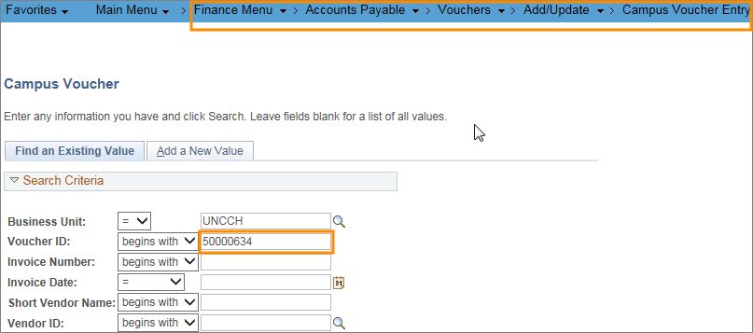
Fixing the Voucher Edit Error
Go to the Campus Voucher page.
Enter the voucher ID identified by the query to be in error and click the Search button.

Slide 24
Fixing the Voucher Edit Error
Click the Invoice Information tab

Slide 25
Fixing the Voucher Edit Error
Find the distribution line with the error and click the Review Errors button.

Slide 26
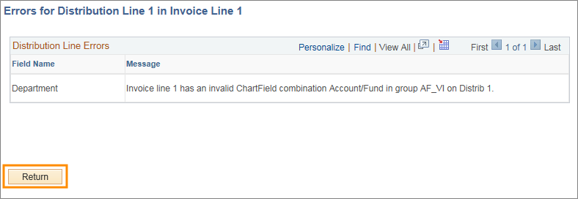
Fixing the Voucher Edit Error
Review the error message to determine the problem with the chartfield string.
Click the Return button to return to the voucher.

Slide 27
Fixing the Voucher Edit Error
Change the appropriate chartfields to correct the error.
Click the Save button which will check the chartfield string for errors.

Slide 28
Fixing the Voucher Edit Error
If the chartfield string is valid for the line you changed, then the Review Errors button disappear.

Slide 29
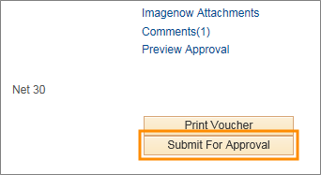
Fixing the Voucher Edit Error
Run the budget check process.
Click the Submit For Approval button.

Slide 30
Budget Queries
Enter the name of the budget query.
Click Search.

Slide 31
Budget Queries: Key Fields
Voucher ID
Ledger Group
Error message
Person who created the voucher
Where the voucher originated

Slide 32
Unposted queries
Unposted queries show all transactions that are not posted. This could include transactions:
With edit errors
With budget errors
Still in approval workflow
It’s best practice to resolve edit and budget errors first, and then run the unposted queries.

Slide 33
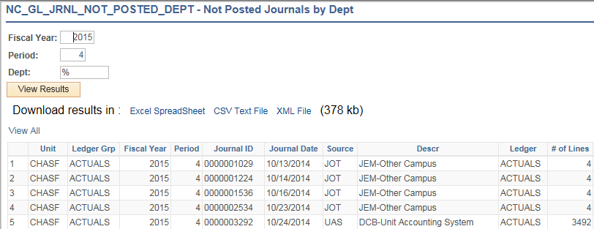
Unposted Journals: Key Fields
Period is by fiscal year month. 1 = July, 2 = August, and so on through 12 = June
No fields can be blank
Returns anything not in Posted status, so V, E, or N
Current approval status and most recent approver

Slide 34
Approval Worklist Queries
Shows transactions currently in a worklist.
Transactions that have been approved or denied won’t appear in this query.
The approval queries are keyed by approver ID. Approvers must be logged in as themselves for transactions to display.
You can only view one person’s worklist at a time.
Approver ID

Slide 35
Queries for Managing Transactions
Navigation to individual transactions
Requisitions: Main Menu > Finance Menu> eProcurement > Manage Requisitions
Purchase Orders: Main Menu > Finance Menu > Purchasing > Purchase Orders > Review PO Information > Purchase Orders
Vouchers: Main Menu > Finance Menu > Accounts Payable > Review Accounts Payable Info > Vouchers > Voucher
Deposits: Main Menu > Accounts Receivable > Payments > Online Payments > Regular Deposit
Budget transfers/journals: Main Menu > Finance Menu > Commitment Control > Budget Journals > Enter Budget Journals/Enter Budget Transfers
Campus Journals: Main Menu > UNC Campus > Campus Journals > Campus Journal Validation

Slide 36
In closing …

Slide 37
Summary
Start preparing for year end now—including spending State funds and cleaning up open transactions.
The 2016 Fiscal Year-End page on the ccinfo.unc.edu website is your go-to place for year end information.
Find the list of queries on the year end page—look for Preparing for Year End Close: Reviewing Open Transactions.
Focus on key fields when looking at query results.
Run queries often to catch errors and things not approved or posted.
If you run a query and there are no results, clear the search fields and run it again to make sure.

Slide 38
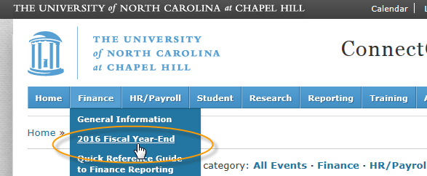
Reminder: Fiscal Year End Page for All Year End Information
For more information about year end close and a recording of this webinar, go to…

Slide 39
?
Questions? (please type questions in the chat window)

