Slide 1
HR/Payroll User Group Meeting
Preparing for the New Year (including Department Changes and Hires)
July 22, 2015

Slide 2
Welcome
Anita Collins
ConnectCarolina
Change Management Lead

Slide 3
Deep dive topic for today:
Preparing for the New Year

Slide 4
Agenda
Topic | Presenter
Department Changes / Position Transfer / Security | Adam Beck
FTE Change | Adam
Return from Short Work Break | Corrie Mimms
Hires and Job Changes | Corrie
Other Updates: •User Conference •Feedback on half day refresher training | Vicki Bradley

Slide 5
Department Changes / Position Transfer / Security
Adam Beck
Interim Senior Director, Classification & Compensation

Slide 6
Position Transfers
New department numbers approved for Fiscal Year 2015/2016 are now in place and active
When transferring positions between departments, you must complete the funding grid (even if there are no changes other than department number) or the budget table will not update
When transferring unpositioned employees between departments, remember to complete the funding grid as well
The “losing” department initiates the transfer, so the receiving department will need to provide the new department number and the chartfield string

Slide 7
FTE Change
Adam Beck
Interim Senior Director, Classification & Compensation

Slide 8
FTE Changes - Positioned Employees
Employees in positions with an annual salary (e.g., SPA Regular, EPA Non-Faculty)
1. Enter position FTE change ePAR and allow it to execute
2. Once the effective date of the position action has arrived, initiate the job data form (Pay Rate Change ePAR) using the same date as the position action
Employees in positions with hourly rates (e.g., SPA Temporary, SPA Student
1. Enter position FTE change ePAR and allow it to execute
No Pay Rate Change ePAR is required

Slide 9
FTE Changes - Unpositioned Employees
Employees not in positions (e.g., Faculty, PostDoc)
Enter job change ePAR, changing both the FTE and the salary, and allow it to execute

Slide 10
FTE Changes - General Notes
Consider payroll lockout schedules and allow enough time for all forms to execute
Especially key for EPA employees, where there is not as much payroll lead time as SPA
The system does not auto-calculate the new salary, so you will need to enter the correct amount
Round salaries to the nearest whole dollar
SPA effective dates should be the start of a work week (Monday)
Best practice for EPA is either a Monday or the first of the month

Slide 11
FTE Changes
Demonstration

Slide 12
Return from Short Work Break
Corrie Mimms
Lead Employment Consultant

Slide 13
Return from Short Work Break Reminders
A Return from Work Break action is required to restart pay
Use the Edit Existing Job ePAR
Extend Expected Job End date, if necessary
Restart EPA Student Pay
Action: Return from Work Break; Reason: EPA Student Reappointment
“Expected Job End Date” is the first day the student will be terminated or on short work break (not the last date worked)

Slide 14
Return from Short Work Break Reminders
School/Division is responsible for processing a Return from Work Break action for EPA students on Short Work Break before the deadline on the August (M02) monthly payroll calendar
ConnectCarolina will terminate any EPA students remaining on Short Work Break in mid-September 2015

Slide 15
Hires, Job Changes, and Compensation
Corrie Mimms
Lead Employment Consultant

Slide 16
Compensation and the Hire ePAR
Always enter ePAR information from top to bottom, left to right
Clicking the Edit Existing Job checkbox before completing other fields on the Hire ePAR will cause errors on the Compensation page
Compensation on Hire ePAR (Hire/Rehire/Transfer)
Rule of thumb: If the individual will be paid for the job, then always enter compensation and funding on the Compensation page of the ePAR.
Compensation does not pull in from the existing job. Therefore, if transferring non-positioned employee from one department to another, always enter the compensation and funding.
Non-compensation job checkbox: Only check this box when the individual will not be paid for the job they are being hired into.

Slide 17
Compensation and the Edit Existing Job ePAR
When completing a Job Change action, if existing compensation and funding will remain the same, then check the box to indicate: I do not wish to update compensation/funding on this action.
Checkbox bypasses the Compensation page of the ePAR and maintains existing compensation and funding
Clicking the Previous button from the Compensation page on the Hire or Edit Existing Job form removes the employee’s existing compensation.
If you use the Previous button and then check the I do not wish to update compensation/funding on this action the employee’s compensation will be wiped out.
Workaround: Put action On Hold and pick it back up, exit the ePAR and start action again, or re-enter Compensation before submitting.

Slide 18
Employee Job Information
Where can I find employee job information?
UNC Employee Information (HR WorkCenter)
Department, Employee status, Regular/Temporary, FTE, Expected Job End Date, Primary/Secondary
Multiple Jobs Summary (HR WorkCenter)
UNC Employee Information details plus UNC Long Title, Position Number, and Compensation
InfoPorte (infoporte.unc.edu)

Slide 19
Other Updates
Vicki Bradley
Director, Office of Human Resources

Slide 20
Revising Business Processes
Future Change: HR/Payroll Calendar Schedule
Currently, have the campus data entry deadline and the Payroll Lockout
Looking at changing to a single School/Division deadline
Actions must be originated and have all School/Division approvals
Will reduce actions from being routed for last minute approvals
Continually examining business processes in ConnectCarolina
Central offices
Business Process Subcommittee of the HR Council
ConnectCarolina project team
Remedy tickets regarding enhancement requests
Engaging with Campus
User Group Meetings
Recent “The Most” meetings
Status Change
Lump Sum
Fund Swap

Slide 21
Upcoming Activities
Town Hall – Aug. 6
User Conference – Oct. 21
Ideas / participation? Contact Debra Beller (debra_beller@unc.edu)
Refresher training

Slide 22
Questions?

Slide 23
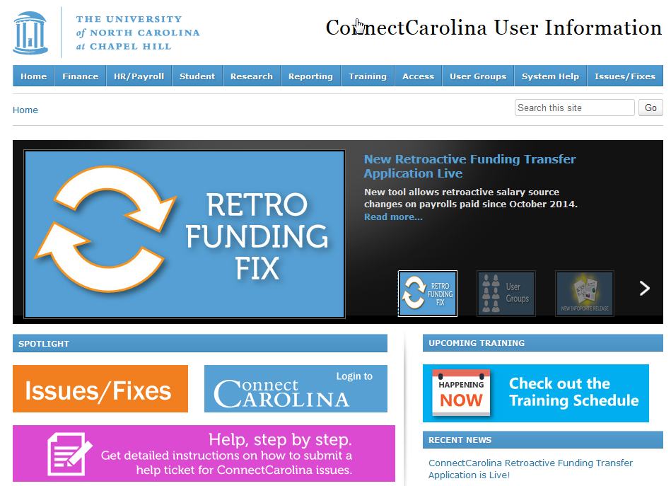
ccinfo.unc.edu

