Slide 1
HR User Group Meeting
January 20, 2016

Slide 2
Agenda
Topic | Presenter | Time
Effort Reporting | Marty Bergerson | 5 min
Retroactive Pay | Corrie Mimms | 5 min
EPA Recruitments and Hires | Corrie | 5 min
Online Help | Anita Collins | 15 min
Various HR Reminders | Corrie | 10 min
PAAT Reminders | Brian Simet | 5 min
Online Tax Forms Reminder | Brian | 5 min
Questions |  | 10 min

Slide 3
Effort Reporting
Marty Bergerson
Manager, Huron Consulting Group
ecrt_help@unc.edu

Slide 4
ecrt Upgrade Overview
Originally implemented ecrt in 2010
UNC is moving from v3.03 to v5.1
Effort Reporting is a hot topic and audit risk
UNC had an A-133 finding in 2014 for timeliness of effort certifications
UNC has not certified effort since the period ending June 30, 2014
New Effort Reporting Policy
Outlines an escalation process for outstanding effort statements
Uncertified statements will have the sponsored funding written off to the F&A account that owns the individual
Upgraded version of ecrt has:
Simplified user interface
Detailed, effort related, transactional level payroll reports by person, project, and time period that can easily be exported to XLS
Reduced administrative burden for Effort Coordinators

Slide 5
ecrt Upgrade Overview
Timeline for FY15
Pre Review
January 20th – February 8th
Certification
February 9th – March 9th
Escalation
March 10th – April 10th
Any effort statement that has not been certified by the end of the Certification and Escalation period will have its sponsored funding removed and transferred to the F&A account of the department responsible for the individual’s HR assignment

Slide 6
Retroactive Pay
Corrie Mimms
Business Analyst

Slide 7
Retroactive Pay
Retro pay automatically calculates for pay cycles where the employee was paid and received paychecks
Three Questions:
Did the employee receive pay in the previous pay period(s) for which the retro is effective?
Was the pay received in the previous pay period(s) for the same Empl Record as the retro pay?
Is the Pay Frequency the same (monthly to monthly or biweekly to biweekly)?
If all questions are “Yes” then the system will automatically pick up retro pay
If one or more answers are “No” then a Remedy ticket is necessary

Slide 8
Retroactive Pay
Exception
Retro FICA exemptions on Job Earnings Distribution do not automatically calculate, therefore a Remedy ticket is required
Examples
Maria is being hired into a paid EPA job effective January 25, 2016. This will be her first job at UNC. Maria’s Hire ePAR did not execute until after the January payroll lockout.
A Remedy ticket is necessary since she will not have received a January paycheck

Slide 9
Retroactive Pay
Examples continued
Micah should have been receiving supplemental pay on his Primary job (Empl Rec 0), but there was a delay in getting the ePAR approved.
As long as Micah received a paycheck during the pay periods the supplemental pay is effective, the system will automatically pay the retro
John is an EPA student who receives compensation for his job on Empl Rec 0. The ePAR to hire John into a secondary job with compensation (Empl Rec 1) did not execute until after the pay period it became effective.
A Remedy ticket is necessary since he did not receive pay from Empl Rec 1 in the previous pay cycle

Slide 10
Retroactive Pay
Reminders
If you are unsure or have questions, submit a ticket
Always monitor prelim reports to ensure accurate pay
For a dock in pay or overpayments, submit a Remedy ticket and Payroll Exception Sheet
Ensure employee’s Job Data is accurate before submitting ticket
FICA retro to a previous tax year will not be adjusted

Slide 11
EPA/EHRA Recruitment Transition
Corrie Mimms
Business Analyst

Slide 12
EPA/EHRA Recruitment Transition
Recruitment and Hiring Changes
EPA/EHRA Non-Faculty, Faculty, and Postdoctoral Scholar
Permanent and Temporary
PeopleAdmin: Effective January 27, 2016 EOC will no longer approve postings, interims, hiring proposals
EOC will continue to approve all Waiver requests
ConnectCarolina: Effective January 27, 2016 EOC will be removed from the approval workflow for Hire actions

Slide 13
PA and CC Workflow Changes
PeopleAdmin Workflow
EPA/EHRA NF: Postings, interims, and hiring proposals will route to OHR Employment
Hiring Proposals will continue to route to EPA NF Office
Faculty: Postings, interims, and hiring proposals will route to Academic Personnel
Postdoctoral Scholars: Postings and hiring proposals will route to VC Research

Slide 14
PA and CC Workflow Changes
ConnectCarolina Workflow
EOC will no longer approve Hire ePARs
All EPA/EHRA NF Hires ePARs will continue to route to EPA NF Office
EPA Hire ePARs will not route to OHR Employment
All Faculty Hire ePARs will route to Academic Personnel, except Faculty Zero Base Rate (CWR)
All Post Doc Hires will route to VC Research
Other ePAR routing will not be impacted

Slide 15
EPA/EHRA Recruitment Transition
OHR Employment staff
Additional two new Employment Consultant (EC) positions
EC assignments will be changing as part of the transition
Updated EC assignments will be distributed in upcoming communication
Reminder: select your assigned Employment Consultant from list when submitting postings, pre-interview and interim pools, and hiring proposals

Slide 16
Online Help
Anita Collins
ConnectCarolina Change Management Lead

Slide 17
Online Help: Where can I find it?
All the content in all the ConnectCarolina training guides (all the step-by-step instructions), in a searchable form
Updated on Fridays

Slide 18
Online Help: Where can I find it?
You can find it two places:
On the CCInfo.unc.edu website
Inside ConnectCarolina

Slide 19
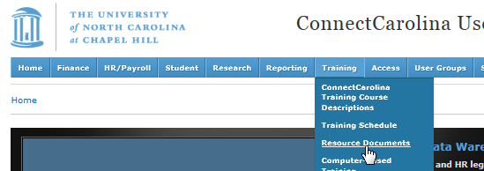
Online Help: Where can I find it?
A. On the ccinfo.unc.edu website
Go to the Training > Resource Documents page
It’s called “ConnectCarolina Actions for HR Representatives”—use the second search box to search for ConnectCarolina Actions

Slide 20
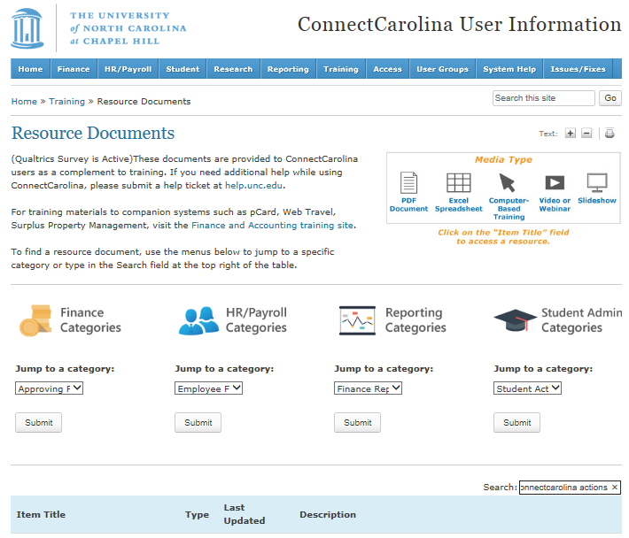
Online Help: Where Is It?

Slide 21
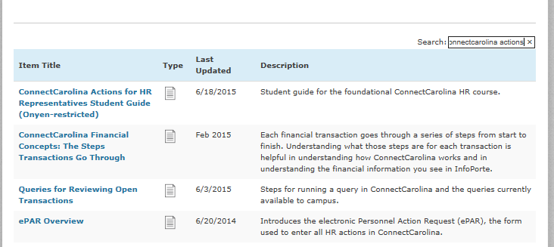
Online Help: Where can I find it?

Slide 22
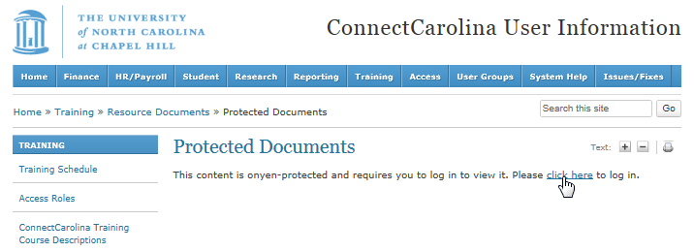
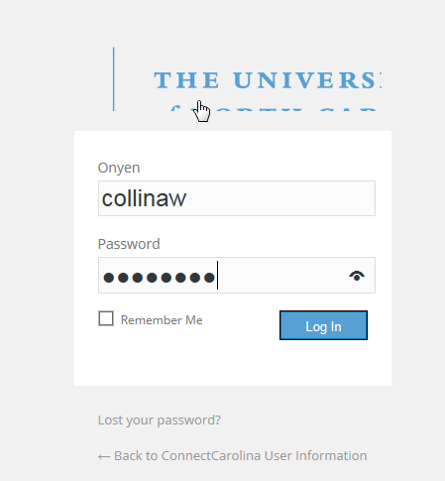
Online Help: Where can I find it?

Slide 23
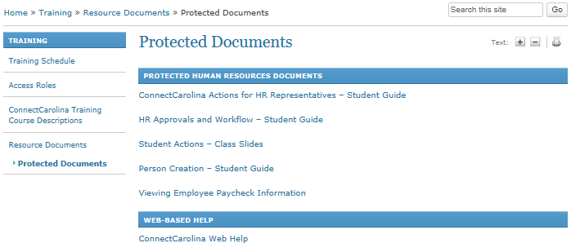
Online Help: Where can I find it?

Slide 24
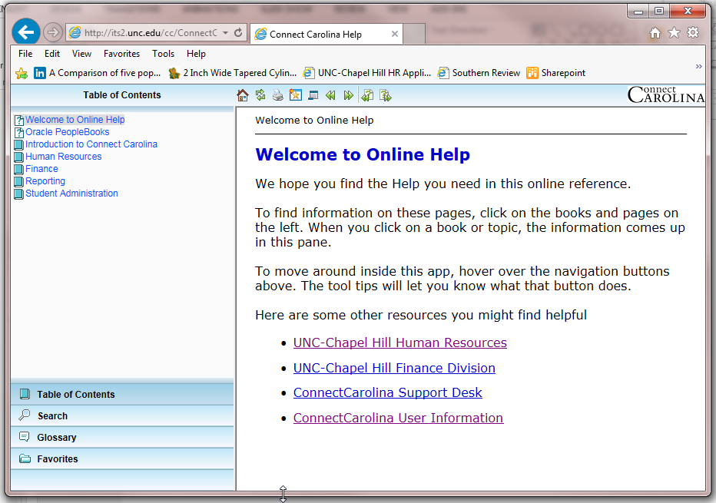
Online Help: Where can I find it?

Slide 25
Online Help: Where can I find it?
B. Inside ConnectCarolina
Top right corner of most screens
EXCEPT the home page

Slide 26
Online Help: Where can I find it?
The help opens in its own window or browser tab

Slide 27
Online Help: How do I use it?
Two key ways: Table of Contents and Searching

Slide 28
Online Help: How do I use it?
Table of Contents

Slide 29
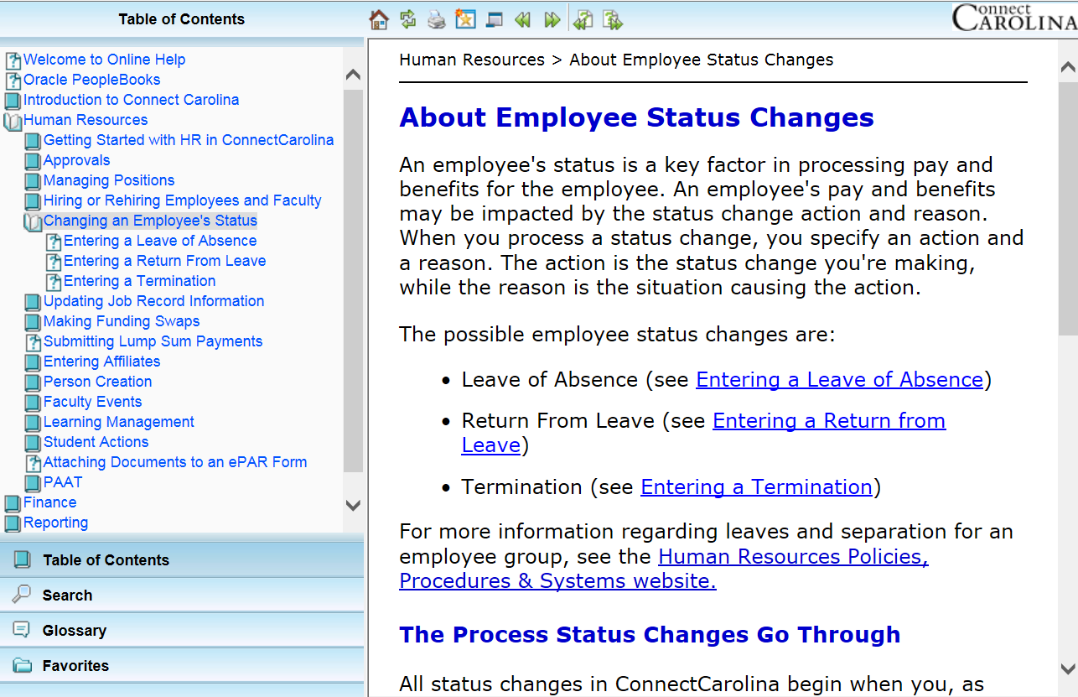
Online Help: How do I use it?
Open the books to see all the pages inside

Slide 30
Online Help: How do I use it?
Home – brings you back to the Welcome page.
Refresh
Print
Add topic to favorites – saves you from having to search for the topic
Hide Navigation
Back
Forward
Previous Topic
Next Topic

Slide 31
Online Help: How do I use it?
You are entering a lump sum payment ePAR and you are unclear about what date you need to enter in the Effective Date field.
Click on the Help link in the top right corner of most screens

Slide 32
Online Help: How do I use it?
Click on the Human Resources chapter in the Table of Contents
Click the ‘Submitting Lump Sum Payments’ topic
Scroll down through the information to the table that defines effective date

Slide 33
Online Help: How do I use it?
You are entering a secondary job for an EPA employee and not sure what FTE to use on the Hire ePAR form.
Click on the Help link in the top right corner of the screen

Slide 34
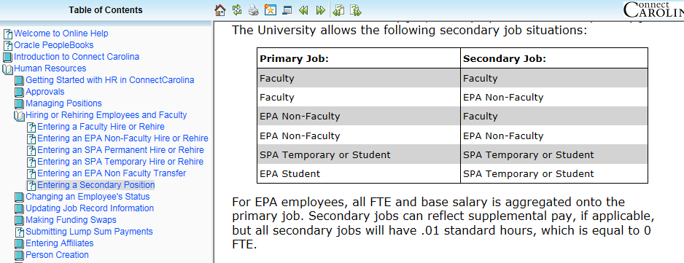
Online Help: How do I use it?
Click on the Human Resources chapter in the online help
Click the ‘Entering a Secondary Position’ topic
Scroll down for information about FTE for EPA secondary jobs

Slide 35
Online Help: How do I use it?
Search

Slide 36
Online Help: How do I use it?
You want to check on a PAAT adjustment to see where it is in the approval process. You’re not sure which PAAT report shows you this.
Click the Help link

Slide 37
Online Help: How do I use it?
Click on the Search function in the bottom left corner, then type PAAT in the Search field and click Search.
Next, click on a title in the search results to see information on that topic on the right side of your screen.

Slide 38
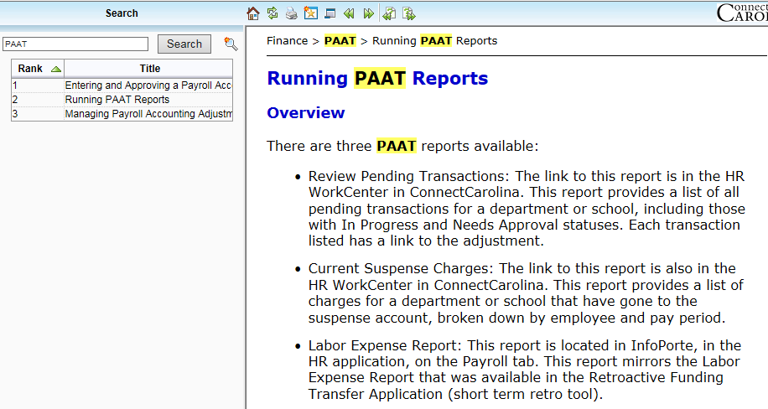
Online Help: How do I use it?

Slide 39
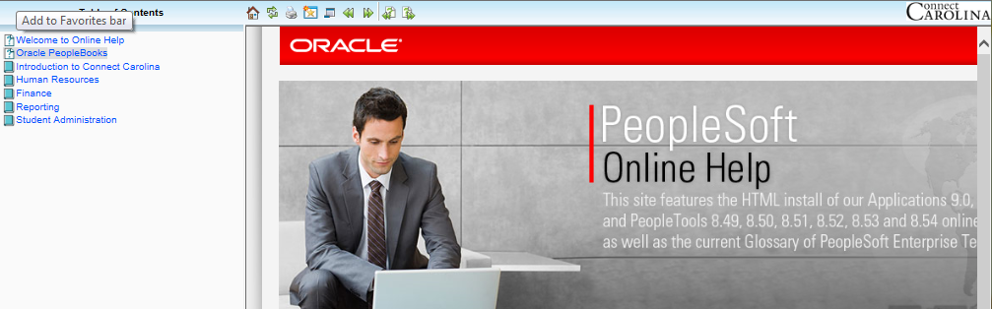
A Note on the PeopleBooks

Slide 40
Reminders
Corrie Mimms
Business Analyst

Slide 41
HR Reminders
Reports To and Supervisor ID
All employees must report to a position or Empl ID
Removing Reports To:
Submit Position ePAR to remove Reports To
After ePAR executes, submit an Edit Existing Job ePAR to add Supervisor ID
Use the same effective date used to remove Reports To
Do not start the Edit Existing Job ePAR until the Position ePAR has executed
Individuals who are not in positions or individuals who report to a Supervisor can have updates made on Edit Existing Job

Slide 42
HR Reminders
Termination vs Transfer
Termination and hire/transfer actions drive reporting, benefits, and compliance
If an employee is moving from one job to another without a break in service, the receiving department should submit a Transfer action via the Hire ePAR
A weekend is not considered a break in service
Use Edit Existing Job checkbox to select which Empl Rec and Job the employee will transfer from
Reminder: do not check the Edit Existing Job checkbox until you have completed all other fields on the first page of the hire ePAR
Notes:
*Make sure to mention that if current department submits a term it can write in on top of the Transfer…

Slide 43
HR Reminders
Termination vs Transfer continued…
If there is a break in service between jobs, then a termination action is required
Current department submits the termination action
After termination has executed, receiving department submits Hire ePAR
If a termination action has been entered in error, submit a Help ticket to have the termination backed out

Slide 44
HR Reminders
Termination ePARs
Terminating employees with multiple jobs
Review Multiple Jobs Summary or UNC Employee Information
Are there other active jobs? Do all jobs need to be terminated?
What are the Expected Job End Dates? (information can also be found in InfoPorte)
Submit termination actions at the same time
If applicable, notify secondary departments of termination/resignation
Termination effective dates cannot be greater than Expected Job End Date
If the termination effective date is after the expected end date, first submit an Edit Existing Job ePAR to adjust the end date

Slide 45
HR Reminders
FTE and Compensation Changes
When an employee is in a position timing is key
Submit the Position ePAR to change the FTE first and let it execute
Then, submit the corresponding compensation change via the Edit Existing Job ePAR using the same effective date
Do not start the ePAR until the position action has executed
If the Edit Existing Job ePAR is started early, the FTE will revert back
If the pay rate change action is not completed the employee will be over or underpaid
The pay rate action does not need to be submitted if the employee is paid hourly, however be sure to include the funding grid in the Position action so the department budget table will adjust accordingly

Slide 46
HR Reminders
FTE and Compensation Changes
When an employee is not in a position:
Submit an Edit Existing Job ePAR and update the FTE and Compensation on the same action
To move an employee to a Zero Base FTE / Zero Salary, submit a Hire action and transfer the employee
Cannot set compensation to zero via the Edit Existing Job ePAR

Slide 47
HR Reminders
Position Information
SPA/SHRA Positions
One-to-one ratio: one employee per position
Vacant positions may be re-used
EPA/EHRA Positions
Recommend one-to-one ratio, but not required
Job Code, Hours, Rate/Compensation, Funding Distribution must be identical for positions with multiple headcount
If an individual in a multiple headcount position is a supervisor, must use Supervisor ID for the employee vs Reports To
Positions are not required for EPA Students

Slide 48
HR Reminders
General Reminders
Include comments in ePARs
Lump Sum Payment effective dates
Use the first day of the pay period that the LSP should be paid out
If retro, use the first day of the current/open pay period
Approvers - review ePAR fields for accuracy
Be mindful of midstack actions
If FTE is greater than 1.09 be sure to coordinate with other departments

Slide 49
PAAT Reminders
Online Tax Form Reminders
Distribution of 2015 W2s
Brian Simet
Payroll Director

Slide 50
Payroll / CA Updates
PAAT Reminder
If you have not done so, please complete online training found at
http://www.unc.edu/connectcarolinacbt/courses/PAAT/index.html
Only takes 27 minutes
Online W4 and NC4 forms
Now available 24 x 7
Will provide employee a sense of what payroll it will be reflected
We do not care how many times an employee changes their withholding status.
Not available to Employees with a lock-in letter and Non-Resident Aliens

Slide 51
Payroll / CA Updates
Distribution of 2015 W2s (cont’d)
Will occur the week of January 25th
Active employees
Delivered to primary department
Available via Self-Serve beginning February 1st
Inactive
Mailed to last home address on file
Available via Self-Serve using Guest ID Access

Slide 52
Payroll / CA Updates
Distribution of 2015 W2s (cont’d)
Associated FAQs
Will be distributed with W2s
Will be permanently posted on our website
Requests for Duplicates
Will be addressed beginning Monday, February 15th

Slide 53
Payroll / CA Updates
Form 1095C - Employer-Provided Health Insurance Offer and Coverage
Benefits Office responsible for distributing.
Will be distributed by IRS extended deadline of March 31, 2016
Questions should be referred to benefits@unc.edu

Slide 54
Questions?

