Slide 1
University Chartfields
Gradstar Webinar
August 5, 2015

Slide 2
Today’s webinar
Duration is approximately 30 minutes
Use the chat window to type your questions
We will answer questions at the end
The webinar recording will be posted on the Reporting tab on ccinfo.unc.edu

Slide 3
Webinar Purpose
The purpose of today’s webinar is to:
Gear up for our heavy season of Gradstar entry
Talk about some new checks in Gradstar you need to know about

Slide 4
Webinar Topics
There are new system checks for Gradstar entries. Why?
How might the new checks impact award recipients?
The new checks:
Edit errors
Budget errors
How you can prevent errors

Slide 5
New Checks in Gradstar

Slide 6
Why were new checks added to Gradstar?
Since go-live, many entries made into Gradstar have had errors
No budget set up
Not enough budget
Amount field with a negative or $0 amount
These errors have kept entries from being posted, causing fairly significant problems in the accounting for awards
The new checks were put in place to prevent these errors going forward

Slide 7
Impact to award recipients
If your Gradstar entries have errors, the new checks will prevent your award recipients from receiving their awards

Slide 8
What are the new checks?
1. Edit Errors
If your entry has an edit error, when you click Save, an error message immediately appears on the screen.
You’ll need to resolve the edit error and re-submit your entry.
The system won’t save entries with edit errors.
Edit errors include:
Ensuring the chartfields you entered exist in the system
Ensuring the chartfields you entered are an allowable combination
Ensuring the number in the Amount field is a positive number. The system doesn’t allow $0 or negative amounts.

Slide 9
What are the new checks?
2. Budget Errors
A new budget checking tool has been added that checks your Gradstar entries for valid budget.
The tool completes the budget check within a day of you submitting the entry.
If your entry has a budget error, you will receive an email notification the next day.
You’ll need to resolve the budget error and re-submit your entry.
The system won’t process entries with budget errors.

Slide 10
How can you prevent errors?
Double-check with your Finance team to make sure you’re using correct chartfield strings and that budget has been set up for them.
Use the new Chartfield Checker tool to check your chartfield strings for budget errors before you enter them into Gradstar.
Double check your work.
Did you put a positive number in the Amount field?
Did you enter the chartfields and amounts you meant to enter?

Slide 11
What if you get a budget error?
You may need to contact your Finance team for help in resolving the budget error.
They may need to work with OSR or the Budget Office, or give you a different chartfield string.

Slide 12
Chartfield Checker

Slide 13
Chartfield Checker
Chartfield Checker allows you to see if a chartfield string has edit or budget errors
You enter chartfield strings one at a time
The system displays the results immediately
There is a Chartfield Checker Quick Reference Card at:
http://ccinfo.unc.edu/finance/chartfield-checker/
Notes:
The first point is the search fields.
The search fields have been enhanced to match the chartfields that we budget by for each fund type.
All of our financial information is now driven by the way we budget.
So the chartfields you enter per fund type are the ones we budget by for that fund type.
So for example, here is a state account. These are all the chartfields that we use to budget for State accounts. Program is an optional chartfield, which is why it has a blue toggle. I
I’ll talk about toggles in a minute.

Slide 14
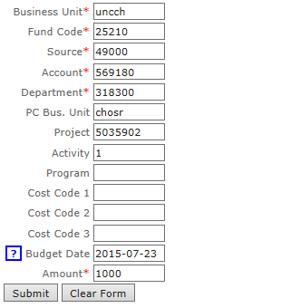
Using the Chartfield Checker
Go to http://ccinfo.unc.edu/finance/chartfield-checker/.
For each chartfield string you need to check, enter the complete string and the amount.
Click Submit.
For OSR projects, be sure to enter the PC Bus Unit, Project, and Activity.
You can enter a future date to see if a project will be passed the project end date.
Be sure to enter a positive amount.
Notes:
The first point is the search fields.
The search fields have been enhanced to match the chartfields that we budget by for each fund type.
All of our financial information is now driven by the way we budget.
So the chartfields you enter per fund type are the ones we budget by for that fund type.
So for example, here is a state account. These are all the chartfields that we use to budget for State accounts. Program is an optional chartfield, which is why it has a blue toggle. I
I’ll talk about toggles in a minute.

Slide 15
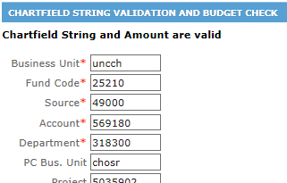
Using the Chartfield Checker
If your chartfield string is “okay”, the system displays a message in black text:
“Chartfield String and Amount are valid”
That string is okay to enter into Gradstar.
Notes:
The first point is the search fields.
The search fields have been enhanced to match the chartfields that we budget by for each fund type.
All of our financial information is now driven by the way we budget.
So the chartfields you enter per fund type are the ones we budget by for that fund type.
So for example, here is a state account. These are all the chartfields that we use to budget for State accounts. Program is an optional chartfield, which is why it has a blue toggle. I
I’ll talk about toggles in a minute.

Slide 16
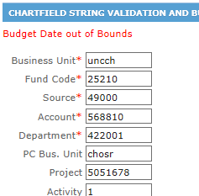
Using the Chartfield Checker
If your chartfield string has an error, the system displays the error in red text, such as:
Budget Date out of Bounds
This string won’t be successful in GradStar, so be sure not to use it until you can get the error resolved with your Finance team.
Notes:
The first point is the search fields.
The search fields have been enhanced to match the chartfields that we budget by for each fund type.
All of our financial information is now driven by the way we budget.
So the chartfields you enter per fund type are the ones we budget by for that fund type.
So for example, here is a state account. These are all the chartfields that we use to budget for State accounts. Program is an optional chartfield, which is why it has a blue toggle. I
I’ll talk about toggles in a minute.

Slide 17
Error Messages
The possible error messages you will see are:
No budget exists
Budget date out of bounds
Exceeds budget tolerance
Invalid Combination
Invalid value

Slide 18
Summary
New checks have been put into Gradstar
An immediate error message for edit errors
An email notification on budget errors
Entries with errors can’t be processed
You can use Chartfield Checker to see if your chartfield string will pass
You may need to have your Finance Team work with OSR to set up a budget, or give you a different chartfield string

Slide 19
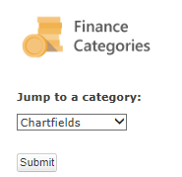
Reference information
Training tab of ccinfo has the Chartfield Checker
http://ccinfo.unc.edu/training/resource-documents/#chartfields
Recording of the webinar
Webinar PowerPoint

Slide 20
Q&A

Slide 21
Thank You

